Slide 1
Patterns of Decision-Making for Feelings of Love and Sexual Desire Associated with Traits of Psychiatric Disorders Characterised by Anterior Insular Cortex Pathophysiology
Isaac McKie

Slide 2
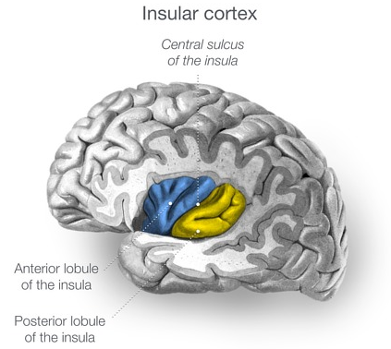
Jones (2009)
Jones, J. (2009). Insular cortex [Diagram]. Radiopaedia.org. https://doi.org/10.53347/rID-5829
Notes:
https://radiopaedia.org/articles/insular-cortex

Slide 3
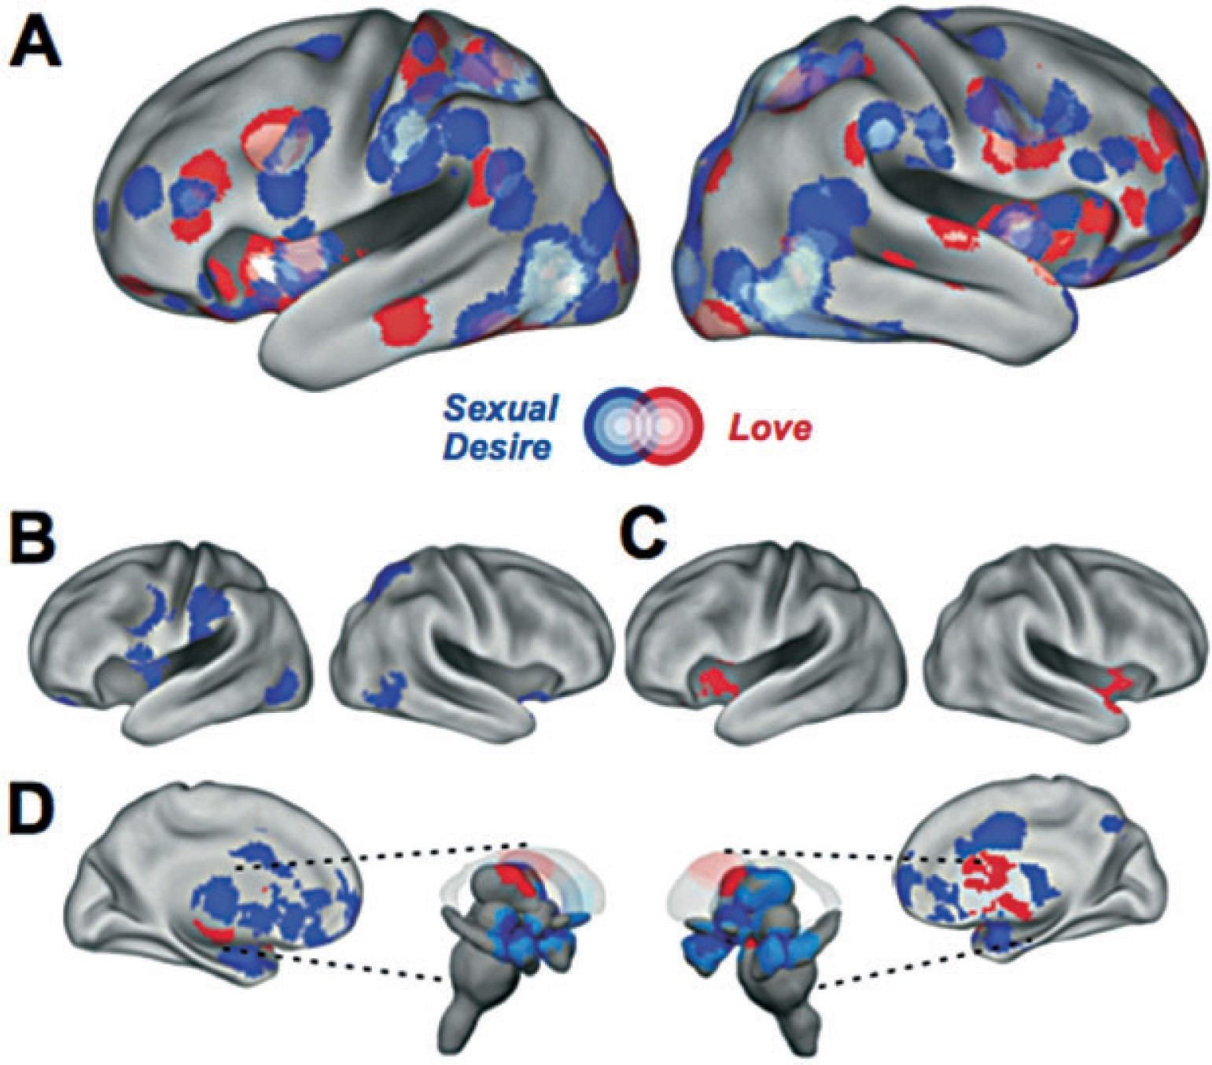
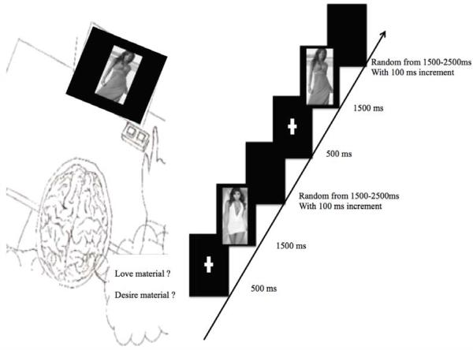
Cacioppo et al. (2012)
Cacioppo et al. (2013)
Cacioppo, S., Bianchi-Demicheli, F., Frum, C., Pfaus, J. G., & Lewis, J. W. (2012). The common neural bases between sexual desire and love: a multilevel kernel density fMRI analysis. The journal of sexual medicine, 9(4), 1048-1054. https://doi.org/10.1111/j.1743-6109.2012.02651.x
Cacioppo, S., Couto, B., Bolmont, M., Sedeno, L., Frum, C., Lewis, J. W., ... & Cacioppo, J. T. (2013). Selective decision-making deficit in love following damage to the anterior insula. Current trends in neurology, 7, 15.
Notes:
https://academic.oup.com/jsm/article/9/4/1048/6886800?login=true

Slide 4
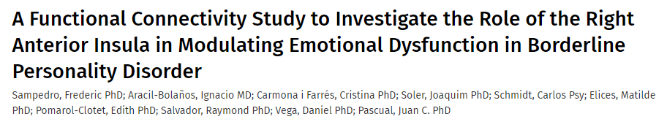
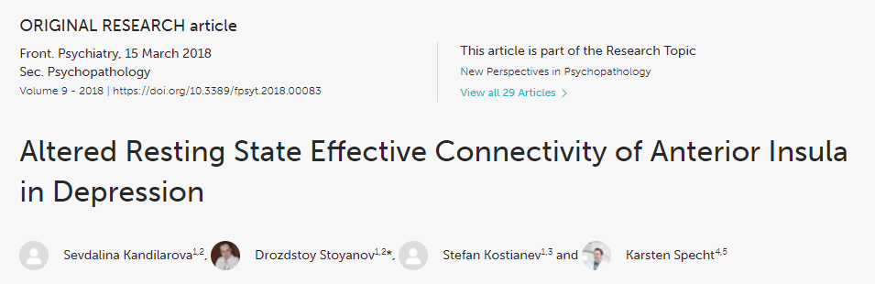
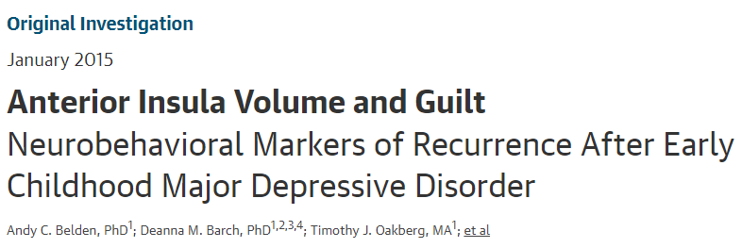
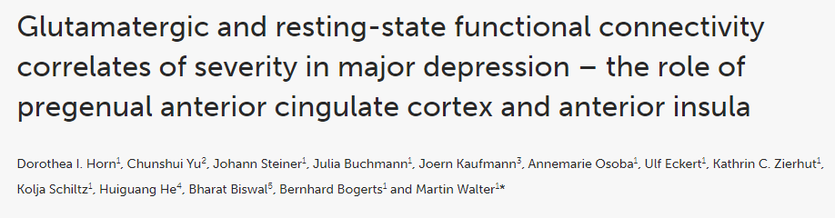
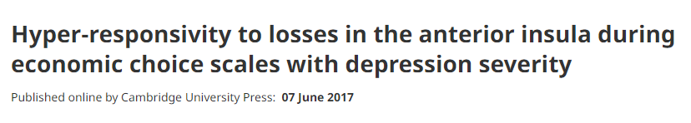
Notes:
https://radiopaedia.org/articles/insular-cortex

Slide 5
Our Study
Center for Epidemiologic Studies Depression Scale Revised (CESD-R)
+
McLean screening Instrument for Borderline Personality Disorder (MSI-BPD)
Love Decision-Making Task
+
Desire Decision-Making Task

Slide 6
Our Predictions
As the anterior insula is implicated in BPD and MDD, alongside feelings of love but not sexual desire, we predicted…
BPD and MDD scores will correlate with response time for making decisions of love but not sexual desire.

Slide 7
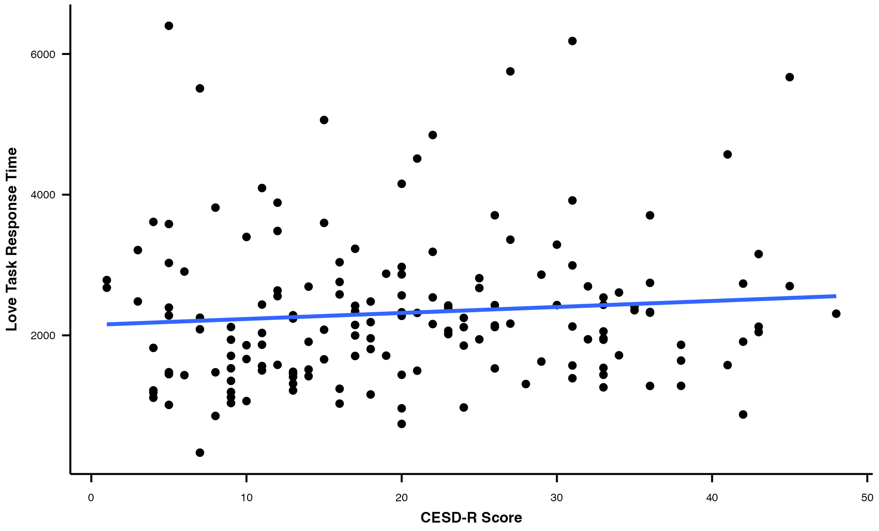
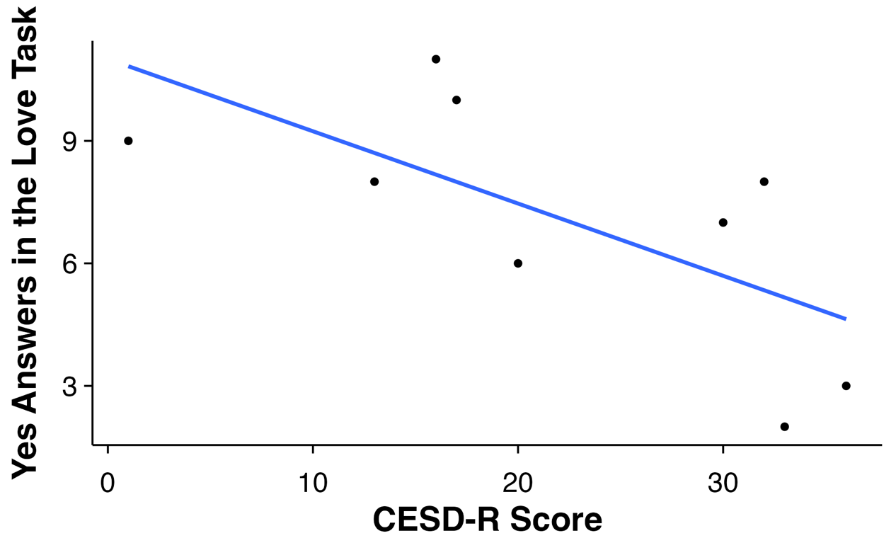
Depression
Some participants showed a (very weak) positive correlation between CESD-R score and response time on the love decision-making task.
Some participants showed a negative correlation between CESD-R score and the number of trials in which they rated stimuli as relevant to feelings of love.

Slide 8
Depression
What does this suggest?
People with depression may show deficits for making decisions of love. This may reflect anterior insular cortex differences as predicted, but future research is needed.

Slide 9
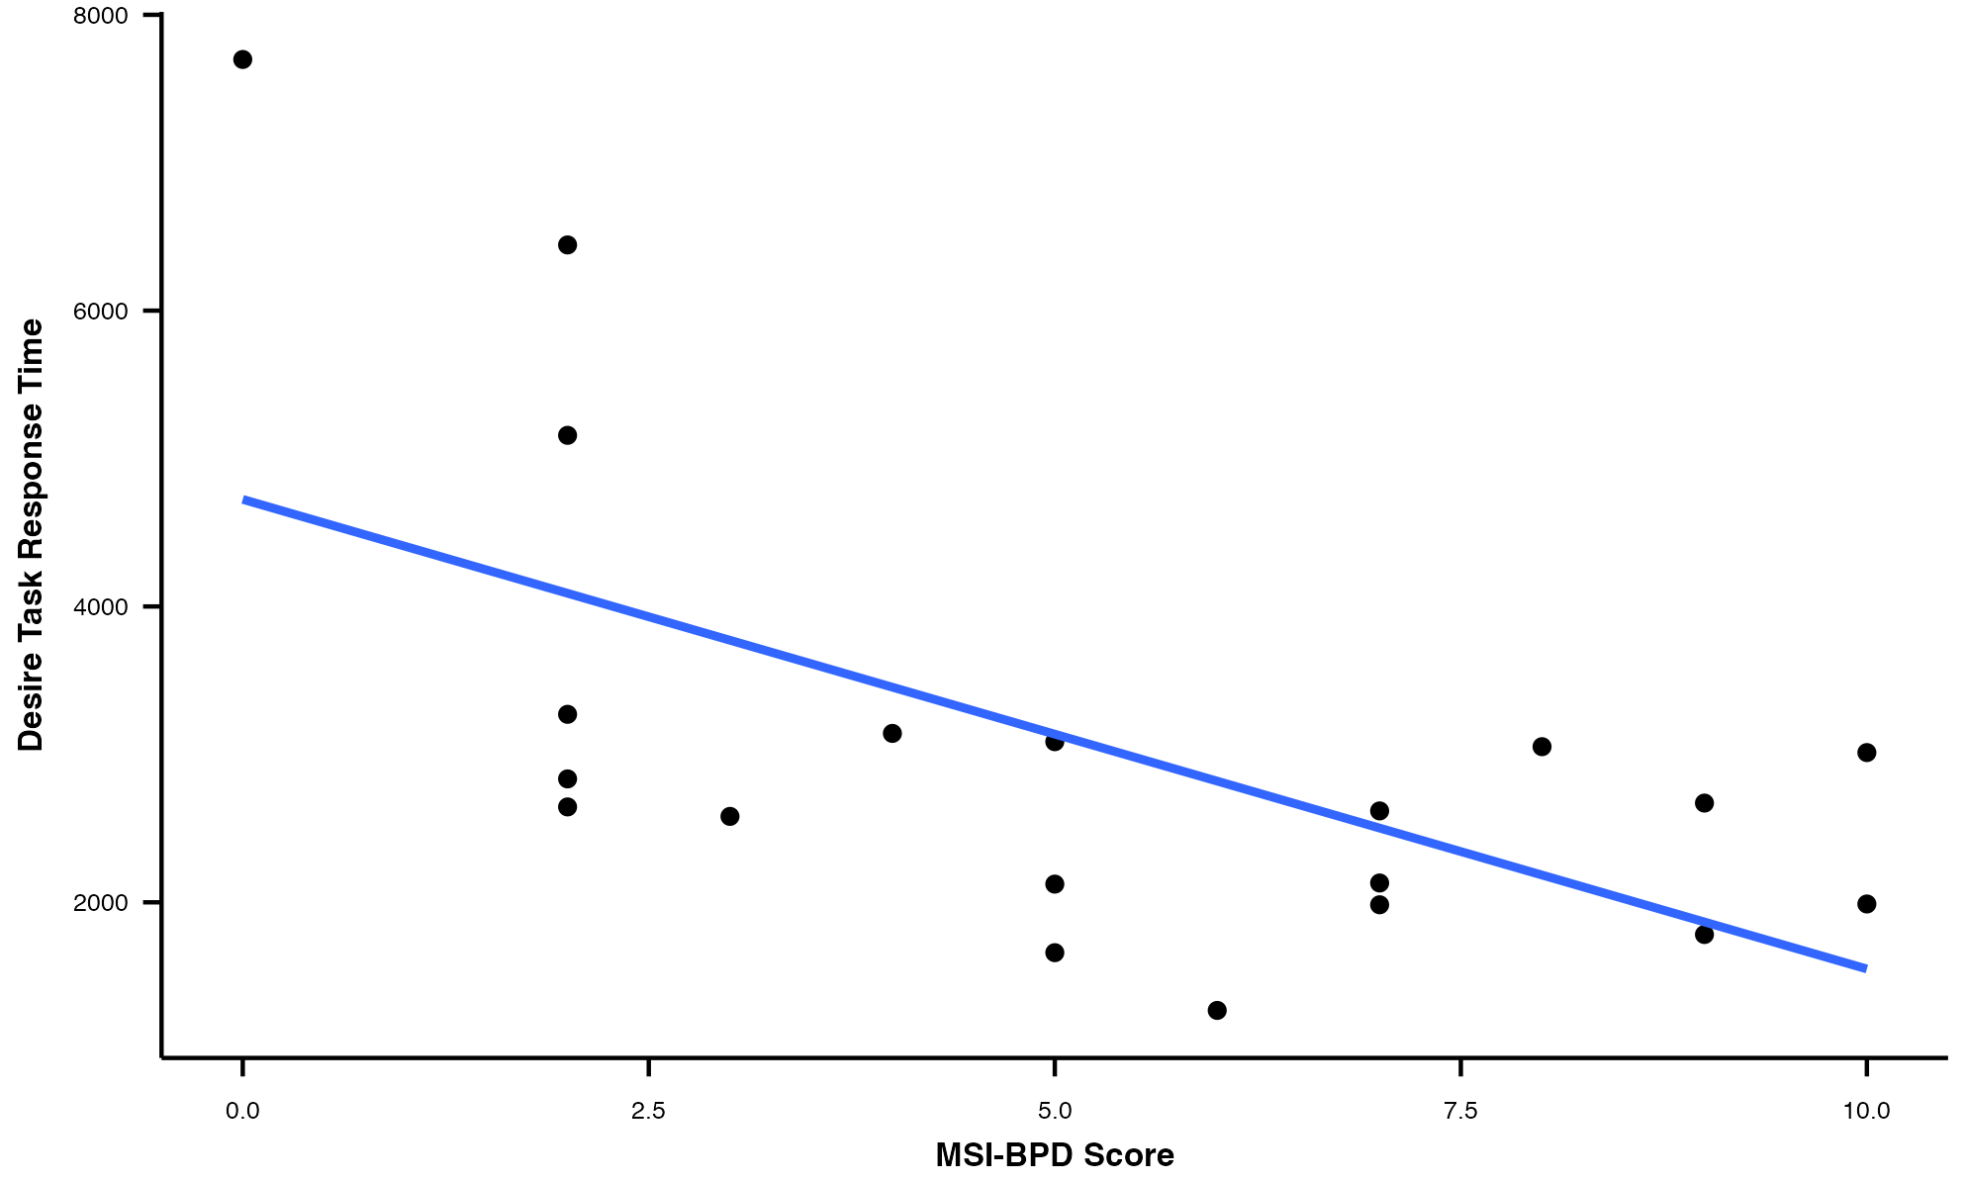
Borderline Personality Disorder
Most participants showed a negative correlation between MSI-BPD scores and the response time on the desire decision-making task.

Slide 10
Borderline Personality Disorder
What does this suggest?
People with BPD may more rapidly make decisions of sexual. This likely does not reflect anything in the insula, and is perhaps more indicative of impulsivity associated with BPD.

